Slide 1

E-commerce Product Analysis using Web Scraping & Machine Learning
GOKUL.L|09 Dec 2024|
JULY ONLINE FN|08.04.2025|

Slide 2
Project Introduction
Objective:
To explore, analyze, and model e-commerce product data for insights and category prediction.
Key Focus Areas:
Understanding product price & rating trends
Clustering products based on features
Predicting product categories using classification models
Tools & Technologies Used:
Python, Pandas, Matplotlib, Seaborn
Scikit-learn, XGBoost, SQLite, Jupyter Notebook

Slide 3
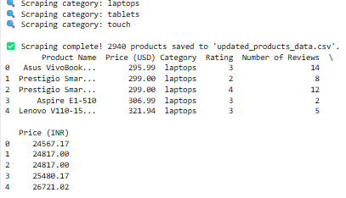
Dataset Overview
Data Description:
Collected 2940 product records using web scraping
Fields include:
Product Name
Category
Price (INR)
Rating
Review Count, etc.
Target Column (for Classification):
Product Category
Unsupervised Features (for Clustering):
Price and Rating

Slide 4
Data Cleaning & Preparation
Initial Issues Found:
Null values in some rows
Price recorded as strings (e.g., "₹999" instead of 999)
Actions Taken:
Dropped nulls and Missing Values
Converted price to integer
Normalized categorical data (e.g., categories with different spellings)
Result:
Clean dataset saved as updated_products_data.csv

Slide 5
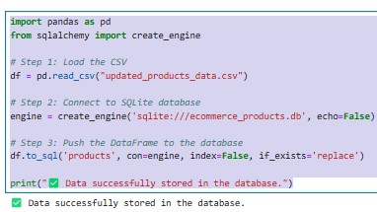
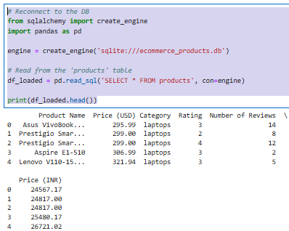
Data Storage in SQL
Why SQL?
Structured, query-friendly format
Easy to access subsets of data
Implementation:
Used SQLite with SQLAlchemy in Python
Stored cleaned data in a products table

Slide 6
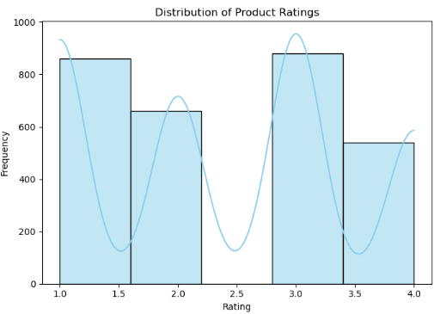
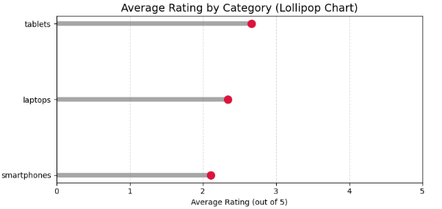
Exploratory Data Analysis (EDA)
Top Categories:
Tablets
Laptops
Smartphones
Distribution of Ratings:
Most products fall between 2.7 and 3.4

Slide 7
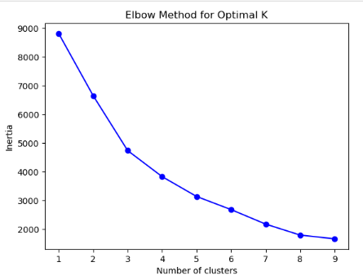
Unsupervised Learning – Clustering
Algorithm Used:
K-Means Clustering
Features Used:
Price (INR) and Rating
Clusters Tried:
3 to 7
Optimal Number of Clusters:
3 (based on Elbow Method)
Use Case:
Helps identify product tiers

Slide 8
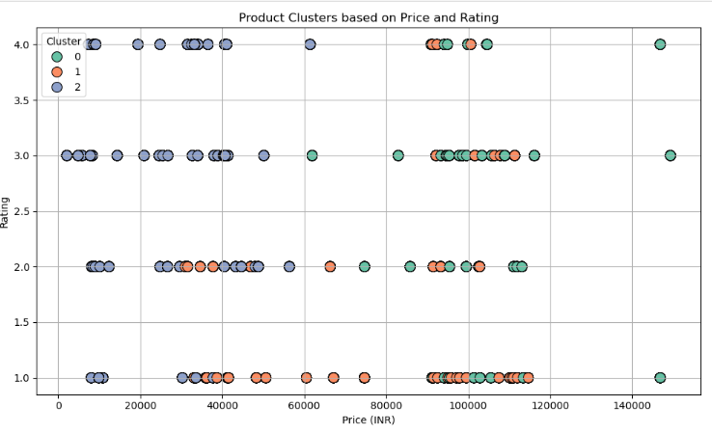
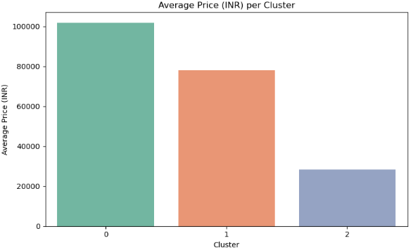
Clustering Visualization
Scatter Plot of Clusters:
X-axis: Price
Y-axis: Rating
Each color represents a cluster
Cluster Insights:
Cluster 0: High price, high rating – Premium products
Cluster 1: Low price, high rating – Value for money
Cluster 2: Low price, low rating – Budget items

Slide 9
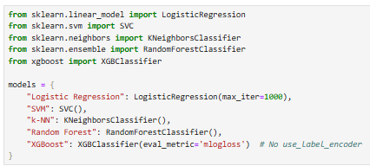
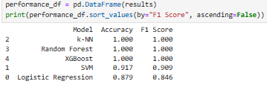
Supervised Learning – Classification
Objective:
Predict the product category
Algorithms Used:
Logistic Regression
Support Vector Machine (SVM)
k-Nearest Neighbors (k-NN)
Random Forest
XGBoost
Data Split:
80% training, 20% testing
Evaluation Metrics: .
Accuracy & F1 Score

Slide 10
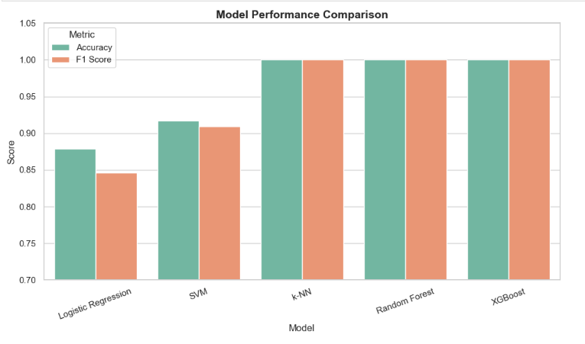
Model Performance Comparison
Conclusion: Tree-based models performed the best

Slide 11
Hyperparameter Tuning
Model Tuned:
XGBoost (best performer)
Technique: GridSearchCV with 5-fold cross-validation
Parameters Tuned:
n_estimators: [100, 150, 200]
learning_rate: [0.01, 0.1, 0.2]
max_depth: [3, 5, 7]
Subsample: colsample_bytree
Best Parameters:
n_estimators=150, learning_rate=0.1, max_depth=3, subsample=0.8, colsample_bytree=0.8 Resulting Accuracy: 100%

Slide 12
Insights & Recommendations
Insights:
Product categories can be predicted using only price and rating
Clustering shows clear segmentation in product tiers
Tree-based models (Random Forest, XGBoost) are very effective
Recommendations:
Use clustering to define pricing strategy
Deploy classification model to auto-tag new products
Combine with customer data for personalized product recommendations

Slide 13
Conclusion & Deliverables
Achievements:
Cleaned and analyzed product data
Built & evaluated five ML models
Identified top-performing model (XGBoost)
Successfully performed clustering
Final Assets:
updated_products_data.csv
products.db (SQLite)
final_model.pkl
Next Steps: Model deployment or integration with e-commerce platforms

Slide 14
Questions & Discussion:
Any Questions?
Suggestions for Improvement?

Slide 15

THANK YOU ALL

